Slide 1

Barley Mow Primary School
Online Safety Session
9th March 2023

Slide 2
Online Safety Survey Years 3/4/5/6
100% use the internet at home
80.5 % have a mobile phone that can access the internet
56% did know how to use privacy and security setting on their device
63.5% answered that their parent did discuss internet safety with them
41.5% answered that they have been set rules on how to use the internet safely at home
96% play online games

Slide 3
Online Gaming can have a range of benefits to our children…
Building resilience
Practicing teamwork
Communication skills
Relatable real-world experiences
Building creativity and imagination
Encouraging problem solving
We must ensure that the environment in which they do so, is as safe as can be.

Slide 4
Social Networking
53% have their own social networking accounts. (Tik Tok, WhatsApp, Twitter, Facebook, Snapchat & Instagram.)
24% share an account with a grown up
Most had Tik Tok and Snapchat.
Age limits
Facebook- 13+
Instagram- 13+
Snapchat- 13+
Tik Tok- 13+
WhatsApp- 16+

Slide 5
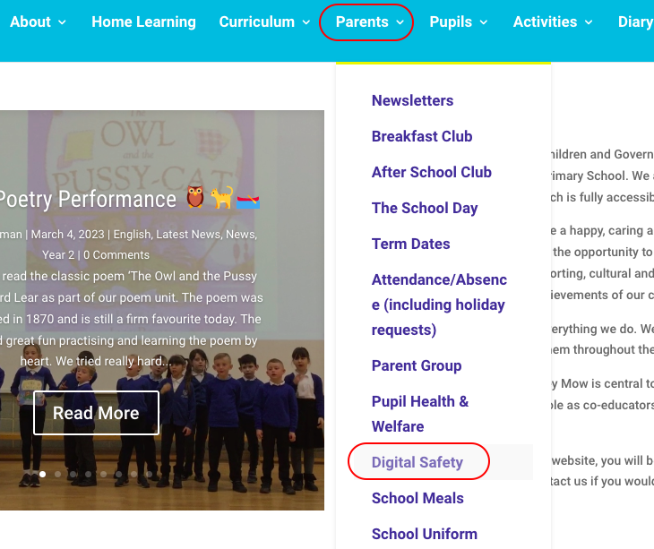

Slide 6
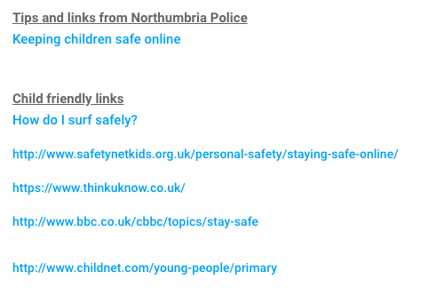
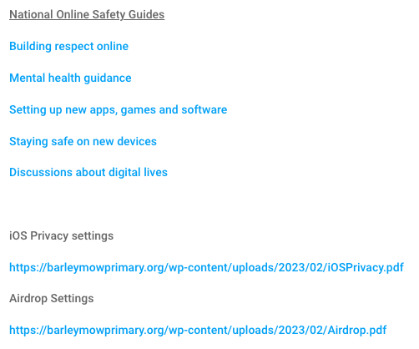




Slide 7
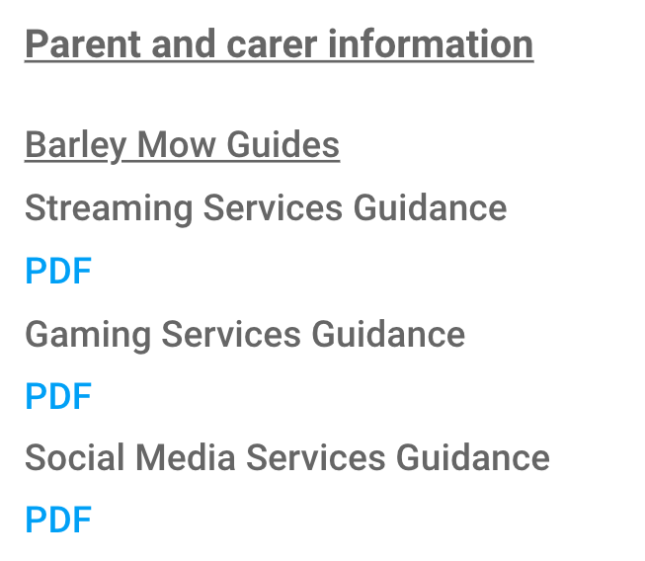
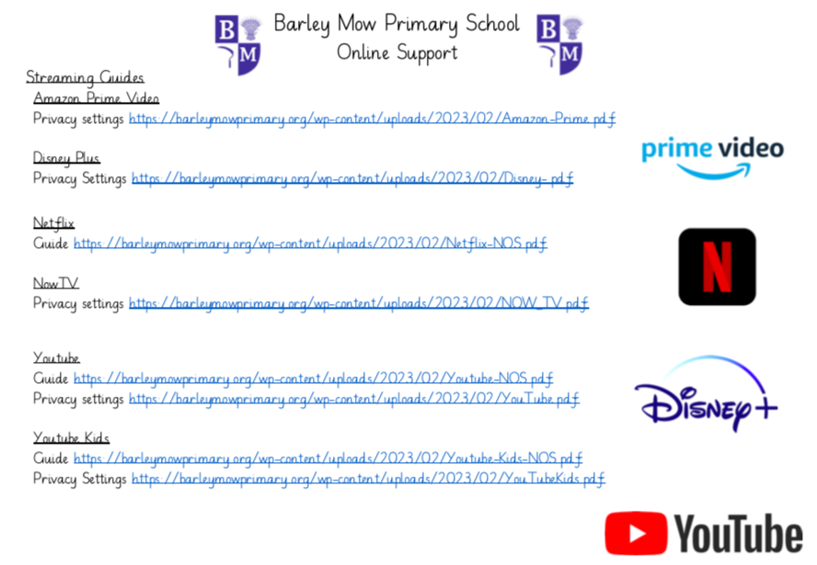

Slide 8
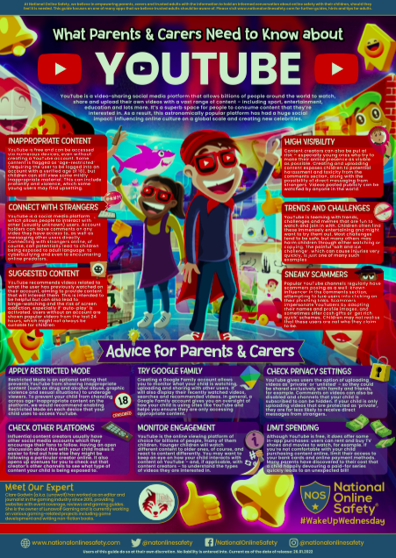
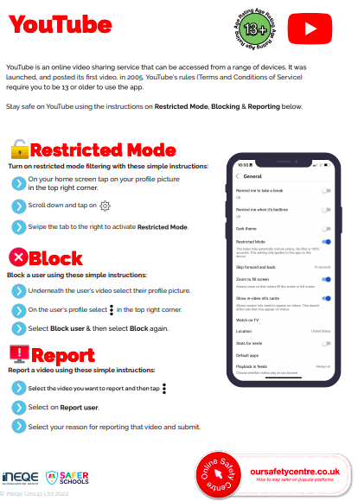

Slide 9
Do the children know who they can talk to?
86% of children said they know who to talk to in school should they encounter inappropriate content whilst online
90% of children said they know who to talk to at home should they encounter inappropriate content whilst online

Slide 10
What are we doing at Barley Mow for your child?
Online safety is regularly taught throughout our computing curriculum with the aim that children leave Barley Mow confident and responsible users of technology.
PSHE lessons on friendship and what to do if they experience uncomfortable situations.
Giving the children a voice and opportunity to talk.
Online Safety day in February

Slide 11
What can you do at home?
Have regular check-ins about what they are watching or playing
Set up child settings on devices and accounts
Set up privacy settings to the highest options
Set up time limits on apps and devices
Set up parent mirroring if available
Talk often about what to do if they see or hear anything that makes them uncomfortable

Slide 12
Any other comments or questions?

